Slide 1


Slide 2

30 Days Data Scinece & Analytics Master Class
Day1 : Python for Data Science
Time: 6.00 PM IST
Free Registration

Slide 3
30 Days Data Scinece & Analytics Master Class
Handbook

Slide 4
NANDHINI.S
Exp: 5 Yrs
Expert in
Python Developer on Machine Learning
Deep learning with computer vision
Matlab – Image Processing
Autonomous Car design using ROS with LIDAR
Language – Python , Java , HTML ,CSS.
Tools – ANACONDA NAVIGATOR, JUPYTER NOTEBOOK,
GOOGLE COLAB.
Graduation : BE – ECE | 2011

Slide 5
Pantech?
Educational Equipment Manufacturer
IoT, AI, Robotics,Autonomous Robot
Microprocessor/Microcontroller
DSP,VLSI, Embedded System
Power Electronics & Drives, Fuel Cell Trainer Kit
Renewable Energy Lab, Electric Vehicle Lab
Technical Training
DIY Project

Slide 6

What is Master Class ?
👍 This is the 30 Days Industrial Learning Activity.
👍 Its Online YouTube Live Class
👍 If you Invest 45 minutes daily, U will become Master in Data Science
👍 You will get FREE E-Certificate
Webinar Participation Certificate
“Learning is the beginning of wealth.
Searching & Learning is where the miracle process all begins.” …………….Jim Rohn

Slide 7
Our Vision
Help 10 Million Students to Learn the Technology in Easy Way

Slide 8

Associate Partner for this Master Class
https://apssdc.in/home/

Slide 9
What U will Learn from 30 Days Data Science & Analytics Master Class

Slide 10





Data Science & Analytics Learning Plan
01
02
03
04
05
Library
Python
Analytics
Tools
Industry Project
Introduction To Python and Python Data Structures
Pandas
Numpy
MatplotLib
Cborn, SKLearn Lib
Collab
Distribution
Visualization
Aggregation
Statistics
PowerBi
Tableo
Project Building,
DSA Jobs

Slide 11
Day wise Learning Plan
Day -1 : Python for Data Science (5 Solved end-to-end Data Science Projects in Python)
Day -2: Advanced Python Programming
Day -3: Pandas Library – Introduction
Day -4: Pandas Library – Data Structures
Day -5: Numpy library – Array Operations | Mathematical Functions
Day -6: Numpy – Sort, Search and Counting Functions
Day -7: Matplotlib , Histogram Using Matplotlib | I/O With Numpy
Day -8: Matplotlib Library – Introduction , Pyplot API | Types Of Plots
Day -9: Seaborn Library
Day -10: SKLearn Library
Day -11: Google Colab Notebook
Day -12: Python – Date and Time, Data Wrangling
Day -13: Python – Data Aggregation
Day -14: Python – Word Tokenization , Stemming and Lammetization
Day -15: Python – Data Visualization

Slide 12
Day wise Learning Plan
Day -16: Python – Statistical Analysis
Day -17: Python – Types Of Distribution
Day -18: Python – Correlation ,Chi-Square Test , Linear Regression
Day -19: Tableau – Introduction and Tools
Day -20: Tableau – Data Sources , Worksheets
Day -21: Spatial Data Science For Covid-19 Disease Prediction
Day -22: Power-BI – Introduction, Installation Steps and Architecture
Day -23: Power-BI – Data Modelling , Visualization Options | Excel Integration
Day -24: Parkinson’s Disease Prediction – XG Boost Classifier
Day -25: House Price Prediction using Random Forest Regression
Day -26: Customer Segmentation Using ML – K-Means Clustering
Day -27: Home Loan Prediction using Decision Tree Classifier
Day -28: Spam Classification using NLP
Day -29: Hand Written Digit Recognition Using CNN
Day -30: Churn Prediction using Deep Learning

Slide 13
List of Projects for Demo in YouTube Live
Spatial Data Science For Covid-19 Disease Prediction
Parkinson’s Disease Prediction-XGBoost Classifier
House Price Prediction-Random Forest Regression
Customer Segmentation Using ML-K-Means Clustering
Home Loan Prediction-Decision Tree Classifier
Spam Classification-NLP
Hand Written Digit Recognition Using Python-CNN
Churn Prediction-Deep Learning
Crop Yield Prediction
Ground water level prediction
All Projects in Jupyter Notebook

Slide 14
What you will get from this Free 30 Days Master Class?
You can attend YouTube Live Class
Free E-Certificate ( WEBINAR PARTICIPATION CERTIFICATE)

Slide 15
How to mark your Attendance in YouTube Live Class?
Ans : During the Live Class, organizer will post Google Form link in Live Chat. The Participants should submit the from on daily basis. Minimum 25 Days Attendance is Required to get Free Master Class Participation Certificate.
Note : The Link will be available during the Live. From the LIVE Class date, the live video will get removed from the YouTube in 3 days.

Slide 16
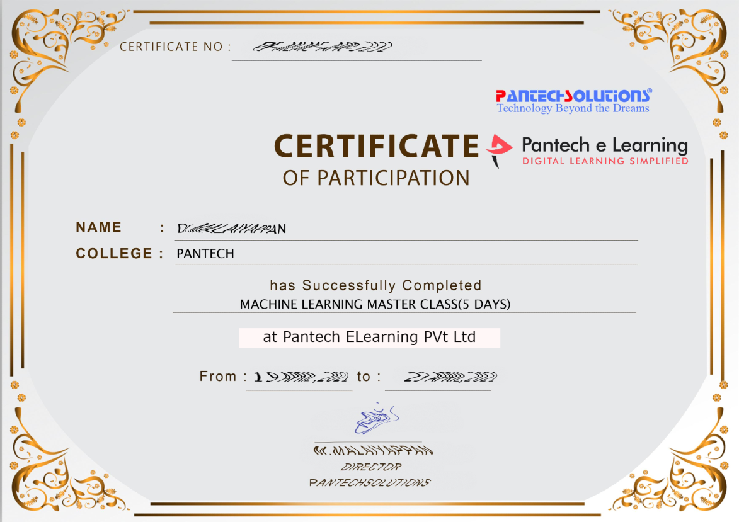

Sample Webinar Participation Certificate?

Slide 17
https://www.pantechelearning.com/data-science-master-class/
On Demand
You can get chance to apply 1 Month Internship on Data Science & Analytics Master Class

Slide 18
What is Internship????
Learn
Practice
Verify
Get Certified
Grow

Slide 19
Free Master Class DSA | 1 Month Internship on DSA
Master Class Participation Certificate | Internship Completion Certificate
Minimum 25 Class should attend YouTube Live | Recorded Class Link will be provided. – LMS Portal Access
YouTube Live Mandatory | Your Choice. You can attend Live or else You can watch Recorded Class in LMS Portal
All Projects Demo class in YouTube Live | Step by Step Video Explanation Content in LMS Portal
Access : 3 Days | VIP WhatsApp Group Support
 | You Can Download All PPTs
 | 4 Nos of Hackathon Class in Zoom Live. The Recording also will be provided
 | You Can Download All Project Files
 | Mentor will guide you to finish 10 Projects
 | Access : 60 Days

Slide 20
Pantech will make you to Create 10 Projects in Data Science & Analytics in 30 Days
Objective of this 30 Days Master Class

Slide 21
1 Month Internship in Data Science
INTERNSHIP E-Certificate(30Days Internship on Data Science Engineering)
Highly organized Video content
Download All Files
Download PPTs
Assignments
Flexible Time.
Access Period: 60Days from the date of payment

Slide 22
What You Will Get???
Complete Project Files
30 Days Learning Activity
Data Science Core Concepts
10 + Projects
Project PPT
Spatial Data Science For Covid-19 Disease Prediction
Parkinson’s Disease Prediction-XGBoost Classifier
House Price Prediction-Random Forest Regression
Customer Segmentation Using ML-K-Means Clustering
Home Loan Prediction-Decision Tree Classifier
Spam Classification-NLP
Hand Written Digit Recognition Using Python-CNN
Churn Prediction-Deep Learning
Crop Yield Prediction
Ground water level prediction
Video Class Access for 2 Months
Get chance to Enroll 1-Month Internship on demand

Slide 23

How to join in 1 month Internship
https://www.pantechelearning.com/data-science-master-class/
Click Here
Coupon Code: DSABATCH4

Slide 24


Slide 25
Decision Tree – Classification algorithm

Slide 26
Decision tree
Decision tree analysis is a predictive modelling tool that can be applied across many areas.
Decision trees are created by algorithmic approach.
It can split the dataset in different ways by applying different conditions.
Decision trees are the most powerful algorithms.
They fall under the category of supervised learning algorithms.

Slide 27
Decision Tree
Decision trees can be used for both classification and regression tasks.
The two main entities of a tree are decision nodes where the data is split and leaves.
Let us take a simple example to predict if the person is a tall person or a short person.
The person is entering.
If the height of a person is more than 6 ft , he is a tall person and if the height is less than 6 ft , he is a short person.

Slide 28
Decision Tree
In a decision tree , the questions are the decision nodes and the final outcomes are the leaves.
There are two types of decision trees.
Classification Decision tree: In this kind of decision tree , the decision variable is categorical.
The above decision tree is an example of categorical decision tree.
Regression Decision tree: In this kind of decision tree , the decision variable is continuous.

Slide 29
Implementing Decision Tree Algorithm
Gini Index: It is the name of the cost function that is used to evaluate the binary splits in the dataset.
It works with the categorical target variable success or failure.
When the value of gini index value is higher , the homogenity is higher.
A good gini index value is 0 and worst gini index value is 0.5(for 2 class) problem.

Slide 30
Implementing Decision Tree Algorithm
Gini index for a split can be calculated with the help of following steps:
First , calculate the gini index for the subnodes by using the formula p^2 + q^2.
It is the sum of square of probability for success and failure.
Calculate the gini index of the split using the weighted gini score of each node of that split.
Classification and Regression tree(CART) algorithm use gini methods to create binary splits.

Slide 31
Implementing Decision Tree Algorithm
Split Creation: A split is nothing but including an attribute in the dataset and the value.
A split can be created in the dataset with the help of following three parts.
Part 1: Calculating Gini Score:
Part 2: Splitting a Dataset:
It is nothing but splitting the dataset into two lists of rows having index of the attribute and split value of the attribute.
The two groups – right and left from the dataset are being collected.
The value of a split can be calculated by finding the Gini score.
Split value will reside in which group the attribute will reside.

Slide 32
Split Creation:
Part 3: Evaluating all Splits
After finding gini score and splitting dataset , we need to evaluate all the splits.
We must check every value associated with each attribute as a candidate split.
One should find the best possible split by evaluating the cost of the split.
The best split will be used as a node in the decision tree.

Slide 33
Building a Tree
A tree has a root node and a terminal node.
After creating the tree , we can build the root node by the following two parts:
Part 1: Terminal Node Creation:
When creating terminal nodes of decision tree , one important point is to decide when to stop growing tree or create further terminal nodes.
This can be done by two important things namely maximum tree depth and minimum node records.

Slide 34
Building a Tree:
Maximum Tree Depth: It is the maximum of nodes in a tree after root node.
We must stop adding terminal nodes once the tree has reached the maximum depth,i.e once a tree has got maximum number of terminal nodes.
Minimum Node Records: It is defined as a minimum number of training patterns that a given node is responsible for.
We must stop adding terminal nodes once the tree reached at these minimum node records or below this minimum.
Terminal node is used to make the final prediction.

Slide 35
Part 2: Recursive Splitting
As we have understood when to create the terminal node , we can start building our tree.
Recursive splitting is a method to build a tree.
In this method , once a node is created , we can create child nodes(nodes added to an existing node) recursively on each group of data.
Child nodes are generated by splitting the dataset , by calling the same function again and again.

Slide 36
Recursive Splitting
Prediction : After building a decision tree , we need to make predictions about it.
Prediction involves navigating a decision tree with the specifically provided row of data.
Prediction can be made with the help of recursive function.
The same prediction routine is called again with the left or right child nodes.

Slide 37
Recursive Splitting:
Assumptions:
The following assumptions are made while creating a decision tree.
While forming a decision tree , training set is taken as a root node.
Decision tree classifier prefers the features to be categorical.
If we want to use continuous values , they must be discretized before model building.
Based on attribute’s values , the records are recursively distributed.
Statistical approach will be used to place attributes at any node position , i.e as root node or internal node.

Slide 38
Implementation in Python:
In this example , we are going to implement the Decision tree classifier on Pima Indians Diabetes Dataset:
First , import all the necessary packages.
import pandas as pd from sklearn.tree
import DecisionTreeClassifier
from sklearn.model_selection import train_test_split
Next , download the iris dataset from the weblink.
col_names = ['pregnant', 'glucose', 'bp', 'skin', 'insulin', 'bmi', 'pedigree', 'age', 'label']
pima = pd.read_csv(r"C:\pima-indians-diabetes.csv", header=None, names=col_names)
pima.head()

Slide 39
DOUBTS:

Slide 40
Recursive Splitting:
Split the dataset into features and target variables:
feature_cols = ['pregnant', 'insulin', 'bmi', 'age','glucose','bp','pedigree']
X = pima[feature_cols] # Features
y = pima.label # Target variable
Next , we will divide the data into train and test split.
The following data will split the data into 70% training data and 30% testing data.
X_train, X_test, y_train, y_test = train_test_split(X, y, test_size=0.3, random_state=1)

Slide 41
Recursive Splitting
Train the classifier with the help of Decision tree classifier of sklearn:
clf = DecisionTreeClassifier()
clf = clf.fit(X_train,y_train)
Then , we need to make prediction .This can be done with the help of following script:
y_pred = clf.predict(X_test)

Slide 42
Recursive Splitting:
We can get the confusion matrix , accuracy score and classification report.
from sklearn.metrics import classification_report, confusion_matrix, accuracy_score
result = confusion_matrix(y_test, y_pred)
print("Confusion Matrix:")
print(result)
result1 = classification_report(y_test, y_pred)
print("Classification Report:",)
print (result1)
result2 = accuracy_score(y_test,y_pred)
print("Accuracy:",result2) from sklearn.metrics import classification_report, confusion_matrix, accuracy_score result = confusion_matrix(y_test, y_pred)
print("Confusion Matrix:")
print(result)
result1 = classification_report(y_test, y_pred)
print("Classification Report:",)
print (result1)
result2 = accuracy_score(y_test,y_pred)
print("Accuracy:",result2)

Slide 43
Output:
Confusion Matrix:
[[116 30] [ 46 39]]
Classification Report:
precision recall f1-score support
0 0.72 0.79 0.75 146
1 0.57 0.46 0.51 85
micro avg 0.67 0.67 0.67 231
macro avg 0.64 0.63 0.63 231
weighted avg 0.66 0.67 0.66 231
Accuracy: 0.670995670995671

Slide 44
DOUBTS:

Slide 45
Visualizing Decision Tree
The decision tree can be visualized with the help of following code:
from sklearn.tree import export_graphviz
from sklearn.externals.six
import StringIO from IPython.display
import Image
import pydotplus
dot_data = StringIO()
export_graphviz(clf, out_file=dot_data, filled=True, rounded=True, special_characters=True,feature_names = feature_cols,class_names=['0','1'])
graph = pydotplus.graph_from_dot_data(dot_data.getvalue())
graph.write_png('Pima_diabetes_Tree.png')
Image(graph.create_png())

Slide 46
DecisionTree Classifier:
Business management.
Customer relationship management
Fraud detection.
Energy consumption.
Fault diagnosis.
Healthcare management.

Slide 47
Advantages and Disadvantages:
Easier algorithm.
Used for classification and Regression problems.
Used for continuous and categorical variables.
It can handle missing values and more robust when compared to other algorithms.
Requires less training period .

Slide 48
Disadvantages:
Overfitting.
Unstable.
Not suitable for large datasets.
Affected by noise.

Slide 49
Follow us on:
Instagram--https://instagram.com/pantechelearning?igshid=1fohp030onteu
Telegram--https://t.me/pantechelearning
YouTube--https://youtube.com/c/PantecheLearning.
Podcasts--https://www.instagram.com/tv/COPQIigJZFi/?igshid=4gjhz4dlls1p

Slide 50
After Internship Registration what you have to do?
Login to www.pantechelearning.com
Access the Video on daily basis for next 30 Days. Practice the Concept and submit assignments
Ask your doubts in VIP Group. Group link is avail in your dashboard.
Finish all the videos and download your Certificate from your dashboard

Slide 51
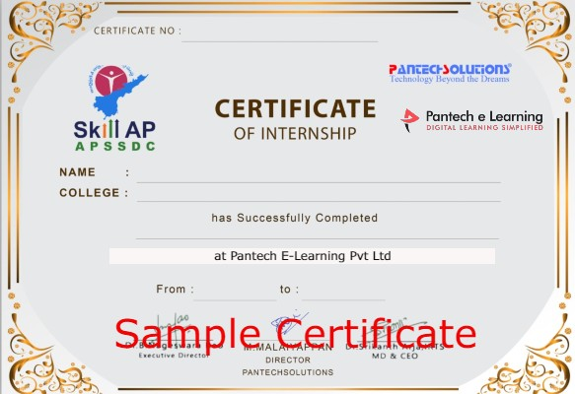
Internship Certificate (Sample)

Slide 52
Happy learning
30 Days Internship on Machine Learning Master Class
Reg Link: https://imjo.in/Rb6xqe
Discount Coupon Code: WELCOMEML
Call / whatsapp : +91 9840974408

Slide 53
THANKS
Further Information:
Senthil Kumar – 98409 74406
Srinivasan – 7010888841
Kumarasamy - 8925533489
www.pantechelearning.com | training@pantechmail.com

Slide 54


